Slide 1
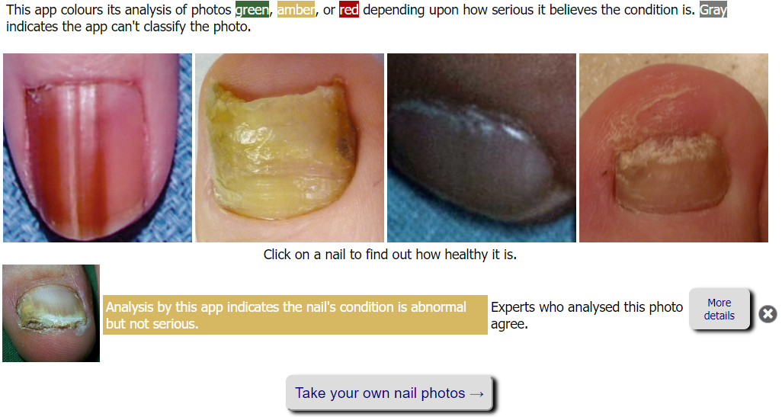
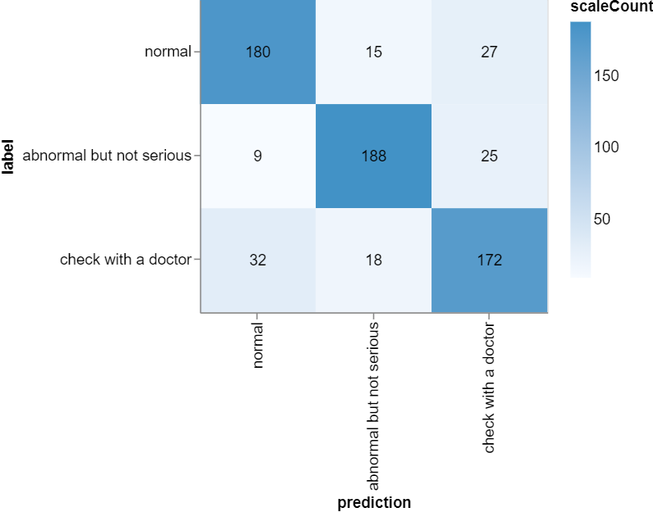
The Onyx Project
A dermatological training module and artificial intelligence health application to support frontline health care staff to screen for health issues.

